Slide 1
Context and Memo
Lecturer: Ngo Huy Bien
Software Engineering Department
Faculty of Information Technology
VNUHCM - University of Science
Ho Chi Minh City, Vietnam
nhbien@fit.hcmus.edu.vn

Slide 2

Objectives

Slide 3

Contents

Slide 4

References

Slide 5
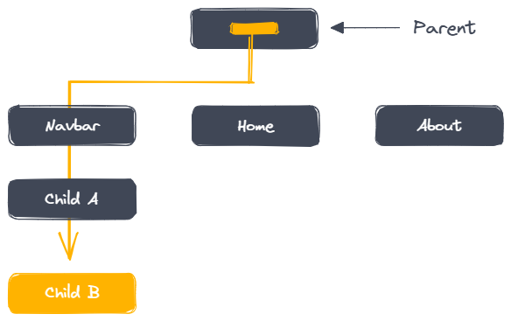
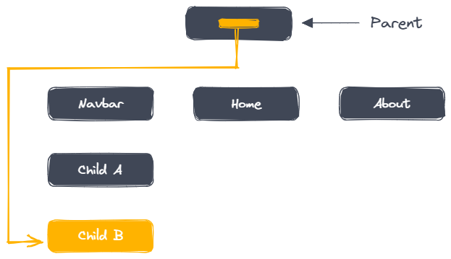
Context API
Context is useful for global state. It is the right tool when you need to share data that can be considered global for a tree of React components.
React solved the problem of parent components having to drilldown props all the way to the children that need to consume them by introducing the Context API.

Slide 6
Use Cases of Context API
Theming
User authentication status
Multilingual support
Sharing data retrieved from external sources

Slide 7
1. Create Context (UserContext.js)
import { createContext } from 'react';
export const UserContext = createContext("");

Slide 8
2. Initialize Context Provider Value (App.js)
import { useState, React } from "react";
import { UserContext } from "./UserContext";
function App() {
const [username, setUsername] = useState("");
return (
<div>
<UserContext.Provider value={{ username, setUsername }}>
</UserContext.Provider>
</div>
);
}

Slide 9
3. Consume Context (LoginInfo.js)
import { useContext } from 'react';
import { UserContext } from './UserContext';
function LoginInfo() {
const { username, setUsername } = useContext(UserContext);
return (
<div>
<h1>Logged in as {username}</h1>
<input type ="text" value ={username} onChange={(e) => setUsername(e.target.value)}></input>
<button onClick={() => setUsername("Hello Context")}>
Click me
</button>
</div>
);
}
export default LoginInfo;

Slide 10
4. Consume Context (MainContent.js)
import { useContext } from 'react';
import { UserContext } from './UserContext';
function MainContent() {
const { username } = useContext(UserContext);
return (
<div>
<h2>Current user: {username}</h2>
</div>
);
}
export default MainContent;

Slide 11
5. Wrap Components with a Provider (App.js)
import { useState, React } from "react";
import { UserContext } from "./UserContext";
import LoginInfo from "./LoginInfo";
import MainContent from "./MainContent"; function App() {
const [username, setUsername] = useState("");
return (
<div>
<UserContext.Provider value={{ username, setUsername }}>
<LoginInfo />
<MainContent />
</UserContext.Provider>
</div>
);
} export default App;

Slide 12


Slide 13
Re-rendering Issue
Imagine the following component structure, where the top level component injects a Context provider at the top:
App (ContextProvider) > A > B > C
If the outermost App component re-renders for whatever reason, all ComponentA, ComponentB and ComponentC components will re-render as well.
If some of your top level components are complex in nature, this could result in some performance hit.
const App = () => {
return (
<AppContext.Provider>
<ComponentA />
</AppContext.Provider>
);
};
const ComponentA = () => <ComponentB />;
const ComponentB = () => <ComponentC />;
const ComponentC = () => null;

Slide 14
memo
If your component renders the same result given the same props, you can wrap it in a call to React.memo for a performance boost by memoizing the result.
After that little adjustment, you will prevent any rendering from happening in all ComponentA, ComponentB and ComponentC if the App component re-renders.
const App = () => {
return (
<AppContext.Provider>
<ComponentA />
</AppContext.Provider>
);
};
const ComponentA = React.memo(() => <ComponentB />);
const ComponentB = () => <ComponentC />;
const ComponentC = () => null;

Slide 15

Thank You & See You Again

